Slide 1
Power BI overview
Sree Ram
Solution Architect Data and AI

Slide 2
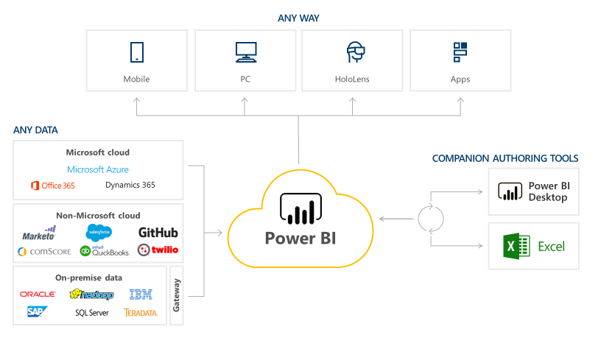
What is PowerBI?

Slide 3
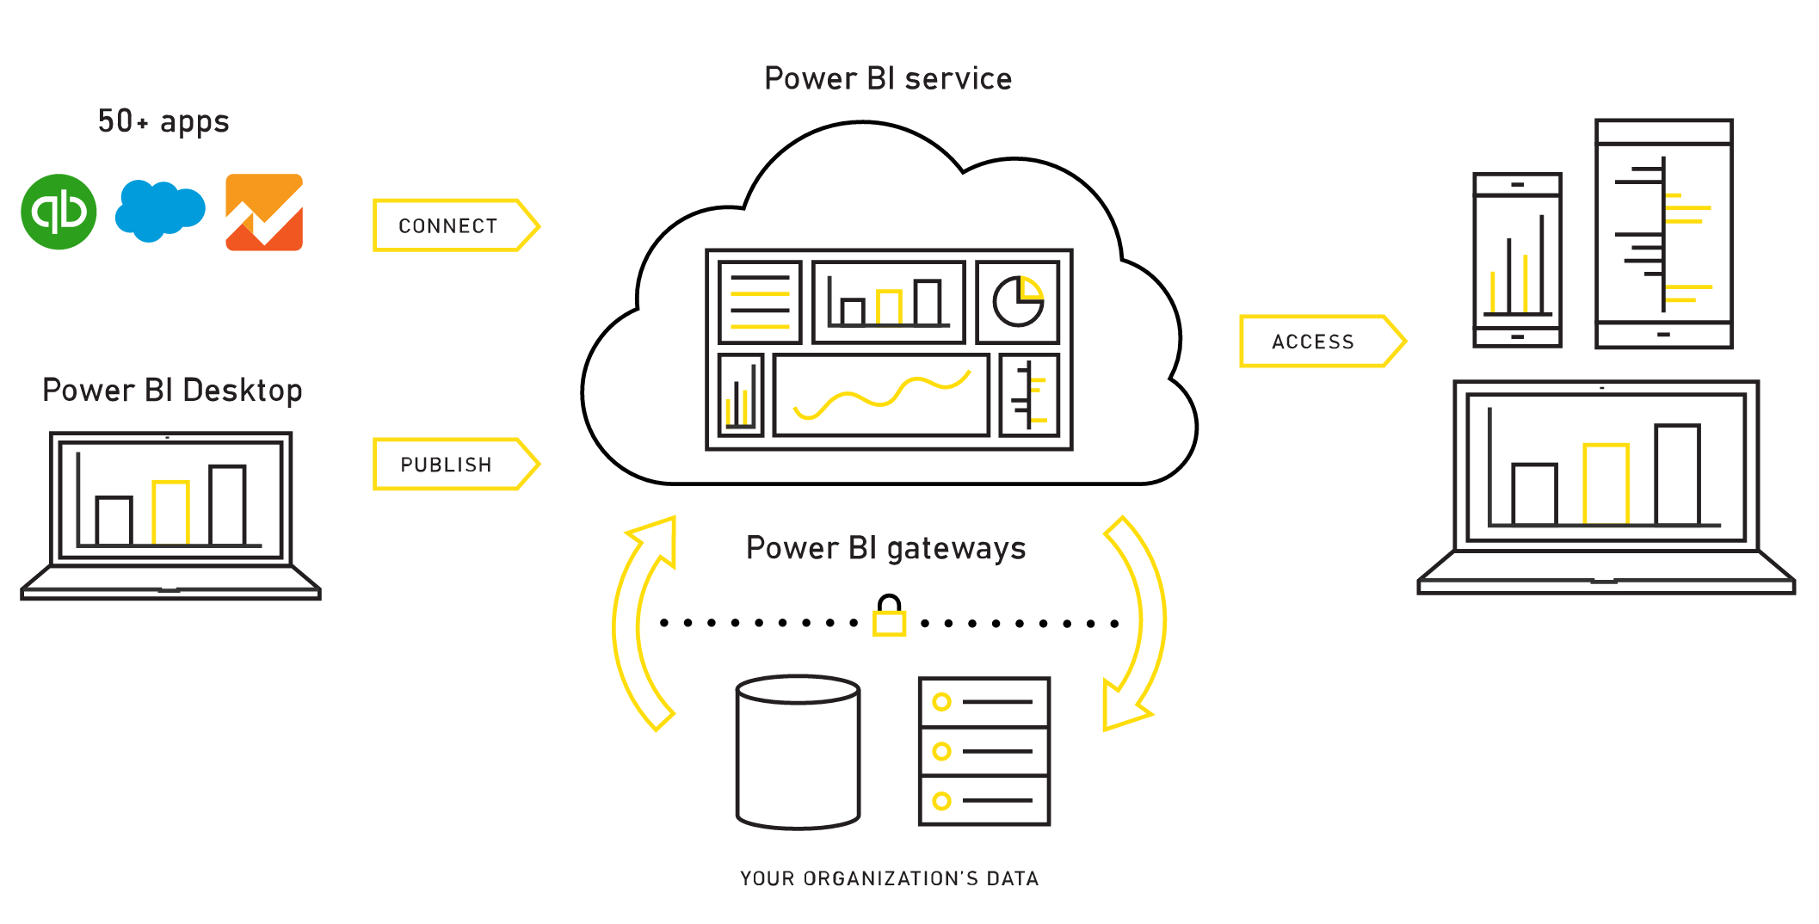
PowerBI Components

Slide 4
Power BI portfolio
Power BI Desktop
Power BI Pro
Power BI Premium
Licensed by user
Licensed by user
Licensed by capacity
Free report authoring and ad-hoc data exploration
Quick, easy-to-use self-service analytics for users requiring collaboration, dashboard sharing, ad hoc analysis, and report publishing
An add-on to Power BI Pro for projects requiring large scale data, demanding performance, and the ability to distribute content without requiring per user licensing

Slide 5
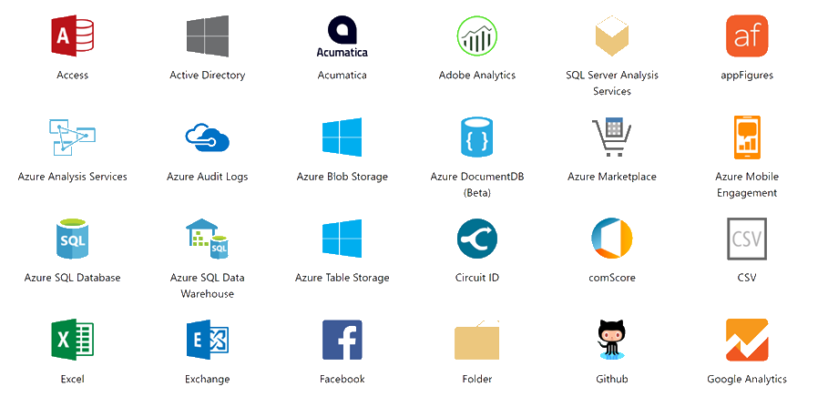
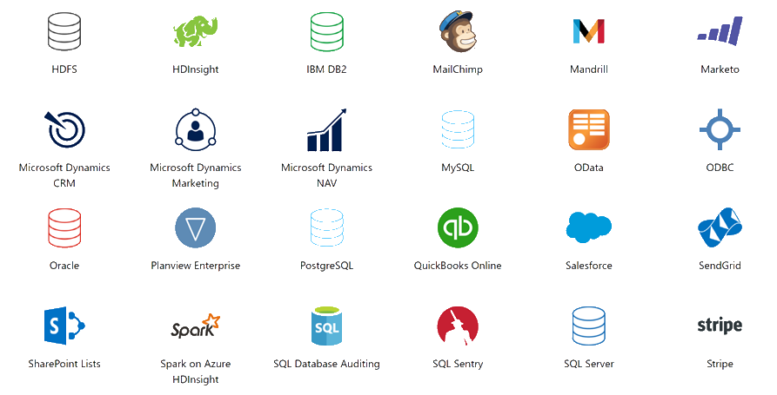
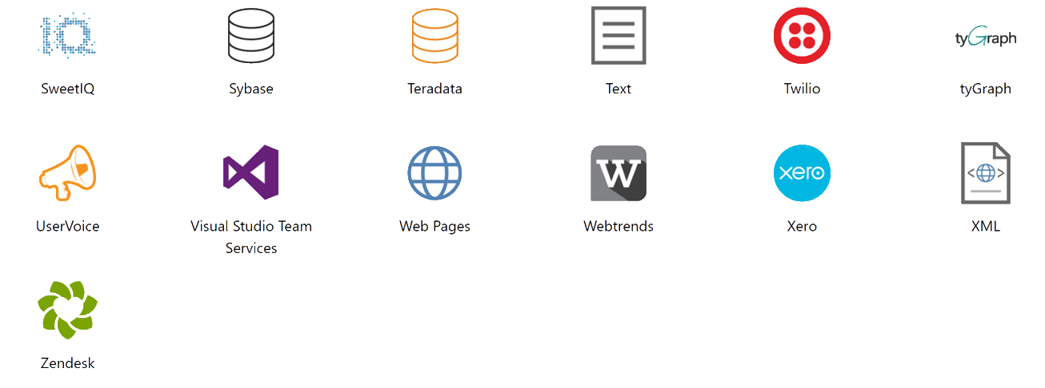
What data sources can I connect to?

Slide 6
Capabilities unique to PowerBI
RT Dashboards
Custom Visuals using Nodejs and D3
Convert Insights into Actions using Power Apps and Flow
Deep integration with Excel or any business application
Natural language capabilities

Slide 7
Provision automatically and deploy at scale
Automate provisioning with Power BI APIs
Easily deploy your solution topology and ‘Golden’ report directory with Workspace API automation
Fully automate the new customer on boarding flow with clone and rebind API automation
Predictable pricing with Power BI Premium dedicated capacity
Dedicated
resources
in the cloud
Greater scale and performance
Power BI Premium
Flexibility to license by capacity

Slide 8
Appendix – New Features last six months

Slide 9
Modeling & Analytics – Last 6 months
2 new Quick Calcs: Percent of row total & percent of column total
Clustering is now generally available
Quick measures (preview)
Q&A in Spanish (preview)
Report level measures for live connections to Analysis Services tabular models & Power BI service datasets
Quick Measures: Total for category & Rolling average
Bin by count
New matrix visual
New table visual
Quick Measures: Star rating & Concatenated list of values
Bi-directional cross filtering

Slide 10
Visuals & Report View – Last 6 months
Table header word wrap
Table & matrix conditional formatting improvement – blank formatting
New aggregations for string and dateTime columns
Phone reports GA
X- and Y-axis font size control
Cartesian chart minimum category width
Line chart line thickness and join type controls
Report theming (preview)
Textbox font color
Numeric range slicer (preview)
Percent of total on pie and donut chart data labels
Cross-highlight using multiple series
Rename axis titles
Relative date slicer & filters
Combo chart data label enhancements
Mailto links in textbox
Accessibility: keyboard & screen reader support
Accessibility: Alt-text for visuals, textboxes and images
Markers on line & area charts
High density line sampling
Control over fonts on visuals
New table and matrix controls
Updated Bing maps API & geocoding improvements
Combo chart axis improvements
New waterfall chart options
Responsive layout for visuals (preview)
Data bars for new table & matrix
Renaming fields in visuals

Slide 11
Custom Visuals – Last 6 months
Time series decomposition (R visual)
Schedule View (R visual)
TextWrapper
Thermometer
Play Axis
Donut 3D
Dual KPI
Enlighten Waffle Chart
Enlighten Stack Shuffle
Enlighten bubble stack
Countdown timer
Cylindrical gauge
Rotating tile
Flow map
Enlighten world flag slicer
Narratives for Power BI
KPI grid
KPI ticker
Dot Plot by OKViz
Enlighten Data story
Drill-down column chart by ZoomCharts
Drill-down donut chart by ZoomCharts
Drill-down column chart for time based by ZoomCharts
Route Map
Drill-down choropleth
Drill-down cartogram
Drill-down player
Certified custom visuals

